Slide 1


SAP S/4HANA CDS, SAC Training Day 14
Anubhav Oberoy

Slide 2
Agenda – Day 14
Connections Basics
Introduction to Connections
Cloud Connector
Connecting to Import data with BW
Connecting to S/4HANA System
---Break---
Build CDS Views
Introduction to CDS View
Consume S/4HANA CDS views
Import data connection
Live Data connection with analytic Query

Slide 3

HANA Live Integration with SAC
HANA Native Development (HANA Consultant – SAP WebIDE for HANA Dev)
HANA Instance needs to be started in SCP
Connect to WebIDE, create a new HANA DB Module
Maintain the service-name as some name inside the mta.yml → sac-hdi
Go to SRC folder inside DB folder and create
A DB table, - an csv file - an hditable - calculation view of type CUBE
Build the module and check the container
2. HANA Adaptor for secure connection to container in HANA (SAP Business App Studio)
Create a new dev workspace
Open workspace projects
Open terminal and type command npm install generator-anubhav-sac
Call yo command and provide container name from step 1 and SAC host url w/o http upto .sap
You will see a project created in bas, navigate to srv/target folder of that project
www.anubhavtrainings.com

Slide 4


























Slide 5
Continue….
Go to sap tools for hana and download the xsahaa-release-1.6.1-release.zip (sha1)
Extract in computer and upload the war file to the folder
Right click to mta.yml file in the adaptor project and click Build MTA
If the build is success we see an mta_archieve with mtar extension.
Right click on MTAR file generated by system and say deploy to CF
Go to CF and Applications inside your dev space
Ideally an app with same name must be up and running
Once the app is deployed, we need to grant auth to our user to access this app
Go to role collection in our trial a/c search for app_Viewer role collection
Click and edit and assign to your email id and Save
Test the adaptor service by adding /sap/bc/ina/service/v2/HeartBeat
3. SAC Live Connection
Add live data connection with HANA of Direct Type
Provide Adaptor URL and enter CF credentials.
www.anubhavtrainings.com

Slide 6
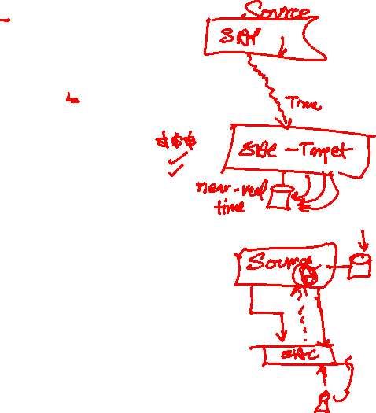
Real SAC system Access
Acquired Data Connection
Connect to real time system only once, and pull all the data into SAC.
Data is stored inside SAC securely, Data security is subjected to SAC
Data needs to updated timely manner, you can schedule auto-updates.
All features can be accessed if its acquired data
e.g. Google drive, S/4HANA Acquired – CDS View
Live Data Connection
Data is never replicated to SAC, it lives in the original system (source system)
Only the skeleton (structure) of the data is represented in SAC Model
All the data transformation and Security is managed by Source System
Data is Real-time and storage cost in SAC is minimal
You can use existing assets like BI Universe, BW Bex Queries, Info providers, CDS views
Performance can go bad at sometime but we can tune
We can perform Close-loop scenario
www.anubhavtrainings.com

Slide 7
Connections
SAP analytic Agent
Public Cloud
Internet
Intranet
Source Systems
BW,BI,S/4H,ABAP,BO,HANA
On premise
SAC
SAP Analytics Cloud System
SAP Cloud Connector
InA
BTP
VPN
PC
S/4HANA, SF
HANA Cloud etc.
Azure, GCP, AWS
InA
Adaptor
www.anubhavtrainings.com

Slide 8
sactrial-sacap10-a5xkyu7zy0i795g99wmt805s.ap10.hanacloudservices.cloud.sap
SAP SAC Server
Browser
Connection to BW or S/4HANA
CORS Headers to browser
Exception to allow CORS call to me from browser
CORS
Cross Origin Resource Sharing
stcfin.st.com:8021/
S/4HANA
BW
ina
Hey! I am fine if someone make a CORS call to me!

Slide 9
CORS
https://sactrial-saceu10-f4aajqsq4u7m952hny9vpm8p.eu10.hanacloudservices.cloud.sap/
SAP Analytics Cloud
SCP
Browser
CORS
CORS Headers
SAC system
BW, BI, BO, ECC….
SAP S/4HANA
On Premise
Special permission
ina
http://sts4dev.st.com:8001/sap/bw/ina/getresponse?sap-client=800
www.anubhavtrainings.com

Slide 10
NW versions required to release CORS Headers
Check the system version of your ABAP based system
NW 7.52 SP02
NW 7.51 SP06
NW 7.50 SP13
NW 7.40 SP20
SAP Kernel Version 7.49PL315
2. Check if INA Service is active in the system. TCOODE: SICF and search for INA service
3. The system must be SSH enabled, HTTPS signed certificate (Network admin)- STRUST
4. Inform Our SAP system that we can offer CORS headers RZ10(system wide-need NW restart)
RZ11 (temporary)
icf/cors_enabled
5. For On-premise systems running in Intranet, you need sap cloud connector
6. Add the settings to issue CORS headers to browser for your SAC system - UCONCOCKPIT
https://help.sap.com/viewer/00f68c2e08b941f081002fd3691d86a7/release/en-US/0d1cd72013804eb78e2aea45a562e439.html?q=uconcockpit
www.anubhavtrainings.com

Slide 11
SAC
HANA
Calculation View
(data model)
ABAP on HANA training 9th April 2022
Weekend 7-9 IST
SAC
S/4HANA (ERP)
CDS View
(data model)

Slide 12
CDS – Core Data & Services
CDS stands for Core Data & Services, these are the data models in ABAP system which is based out of HANA DB. We have 2 types of CDS
ABAP CDS – ABAP system which runs on HANA
HANA CDS – Do not have ABAP system at all, we have just HANA
These are used to expose data out of system in form of Views.
ABAP on HANA – ADT
Native HANA – HANA WebIDE
With SAP S/4HANA system, There is NO BW system required anymore. SAP delivers 1000s of cds views for ready to use consumption.
www.anubhavtrainings.com

Slide 13
<Title>
Fiori App
BI Tools
Portal
SAC
Consumption Views
Consumption Views
Data Models
Interface Views
Interface Views
Interface Views
Private Views
Private Views
Private Views
Private Views
DB Tables
DB Tables
DB Tables
DB Tables
www.anubhavtrainings.com

Slide 14
Acquire Data Connection
Create a CDS View
Activate
Activate Odata service
Create an Acquire data connection
Pull all data from system and show in a dashboard
Sales

Slide 15
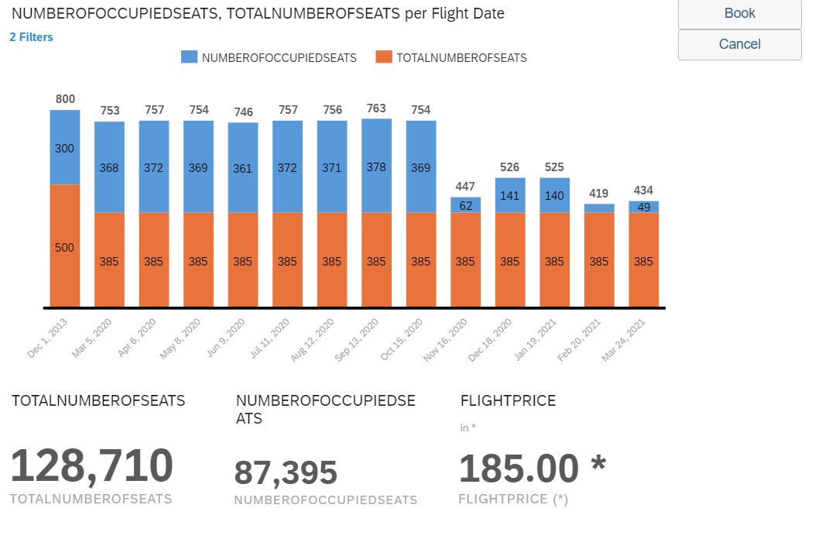
<Title>
www.anubhavtrainings.com

Slide 16

Questions?

Slide 17


Thank you
Anubhav.abap@gmail.com
contact@anubhavtrainings.com
+91 84484 54549
www.anubhavtrainings.com

